Slide 1

Enhancing Search Engine Relevance for
Video Subtitles
Prepared by:
-> Ajay Chaudhary(IN1240153)
-> Sapna Limbu(IN1240692)
Team ID :- T211009

Slide 2
OBJECTIVE
Develop an advanced search engine algorithm that efficiently retrieves subtitles based on user queries, with a specific emphasis on subtitle content. The primary goal is to leverage natural language processing and machine learning techniques to enhance the relevance and accuracy of search results.

Slide 3
INTRODUCTION
Search Engine is a tool that helps to extract relevant contents from the huge amount of data. In the current landscape, Google maintains a steadfast commitment to ensuring a seamless and precise search experience above all other considerations.
Our project focuses on improving the search relevance for video subtitles, enhancing the accessibility of video content.

Slide 4
TYPES OF SEARCH ENGINE
Based on how searching action is done, search engine can be categorized as
Keyword based Search Engines
Semantic based Search Engines
Keyword Based Search Engine: These search engines rely heavily on exact keyword matches between the user query and the indexed documents.It focus primarily on matching exact keywords in documents
Semantic Search Engines: Semantic search engines go beyond simple keyword matching to understand the meaning and context of user queries and documents.aim to understand the deeper meaning and context of user queries to deliver more relevant and meaningful search results.

Slide 5
STEP BY STEP PROCESS
Part 1: Ingesting Documents
Data Sampling
Data preprocessing
Document chunker
Text vectorization
Storing Embeddings
Part 2: Retrieving Documents

Slide 6
Part 1: Ingesting Documents
Data Sampling
Dataset provided was in .db format. As it contained huge amount of data we took 30% of it and converted into .csv format which made us easy to preprocess on it.
Data preprocessing
Data cleaning is necessary before analysing it. It involved:
Decoding the subtitles with “latin-1”
Removing timestamps
Standardizing text to lowercase
Removing symbols and punctuation marks
Removing unwanted words

Slide 7
Document chunker
Subtitles are chunked into smaller chunks to ensure that no information is lost during embedding. Embeddings is done to convert words into numerical form that is machine friendly.
Text vectorization
BERT is used for generating embeddings of the given subtitles.It is based on
“SentenceTransformers” to generate embeddings which encode semantic information.
Storing Embeddings
ChromaDB is used for storing the embeddings as it is suitable for storing the vector representations.

Slide 8
Part 2: Retrieving Documents
Take the user's search query.
Preprocess the query (if required).
Create query embedding.
Used cosine distance to calculate the similarity score between embeddings of documents and user search query embedding.

Slide 9
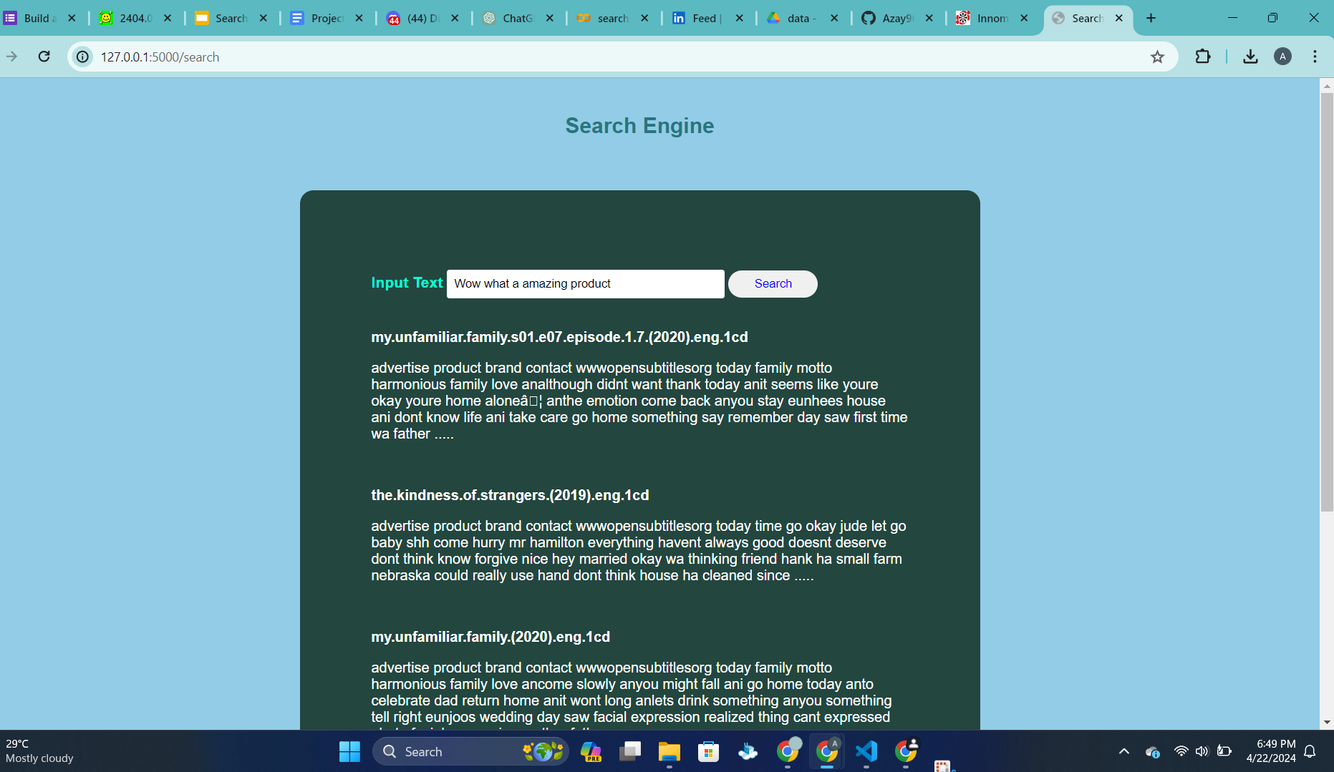
RESULTS

Slide 10
CONCLUSION
By following the step by step process as mentioned above our project “Search Engine web app “ on movie subtitle datasets was successfully built that enhanced searching within video subtitles.

Slide 11

THANK YOU

